Slide 1
BRITISH AIRWAYS
Analyzing and Scraping customer review data

Slide 2
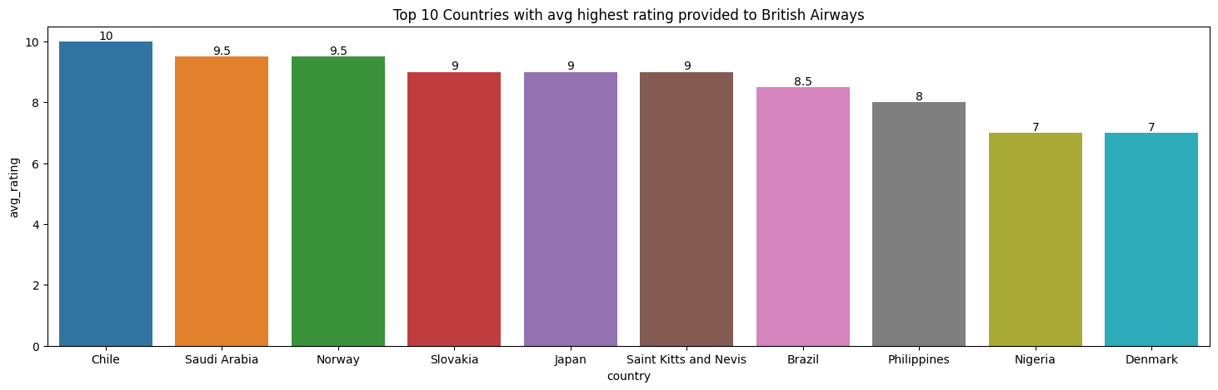
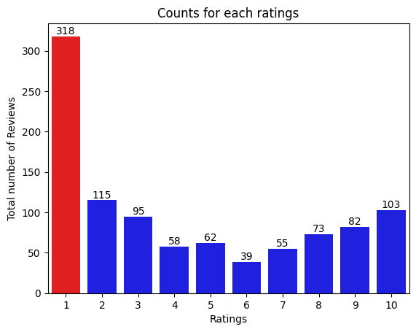
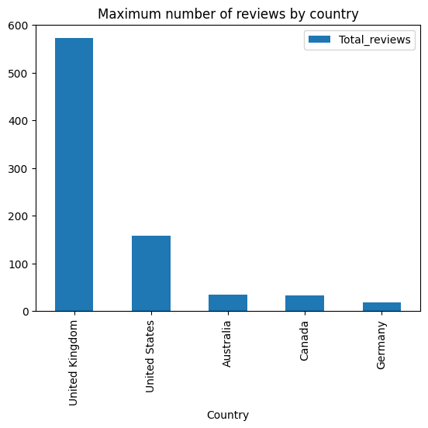
Key Metrics
Average Overall Rating 4.35/10
Reviews from 54 countries
1000 Total Reviews collected
Maximum number of reviews were given by United Kingdom followed by United States and Australia which implies that people flying with British Airways are most likely to be from these countries.
Maximum reviews gave 1⭐ rating followed by 2⭐ then 10⭐

